Slide 1
CLASS - III
SUBJECT – MATHEMATICS
TOPIC – DIVISION

Slide 2
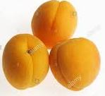
INTRO.
The division is a method of distributing a group of things into equal parts.
ACTIVITY
There are 9 apricots in the fruit bowl for 3 siblings . How many each one will get?
Ans: Sibling 1
Sibling 2
Sibling 3

Slide 3
LEARNING OUTCOMES
Representing and explaining division using equal sharing and equal grouping.
Relating division to repeated subtraction.
Relating division to multiplication
Modelling equal sharing and grouping using concrete and visual representations.

Slide 4
LEARNING OBJECTIVES
Determine that division is dividing objects into equal groups.
Define these terms: dividend, divisor, quotient and remainder.
Recognize that division is the opposite of multiplication and repeated subtraction.
Describe the properties of division.

Slide 5
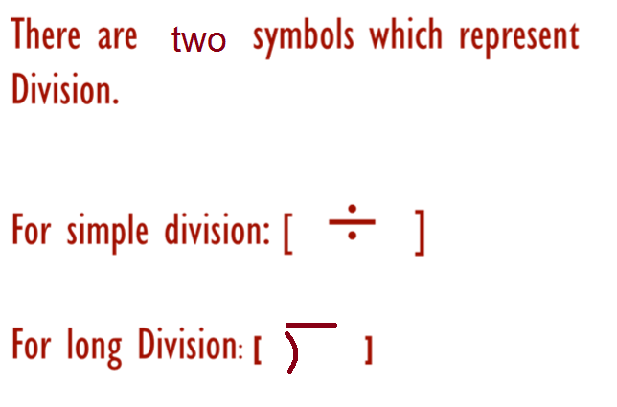
SYMBOLS OF DIVISION

Slide 6
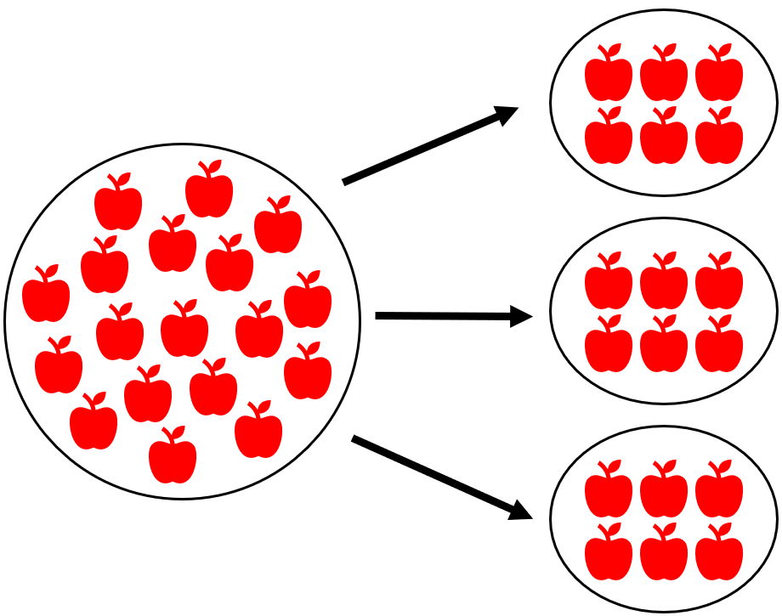
DIVISION BY GROUPING
There are total 18 apples in the big circle.
When we group them in to three small circles , then we get 6 apples in each small circle.
It means, 18 $÷$ 6 = 3

Slide 7
WORKSHEET- 1

Slide 8
REPEATED SUBTRACTION
Example: 20 $÷$ 5 = 4
Step 1: Subtract both the numbers that are given in the question.
Step 2: Subtract repeatedly the second number from the answer you get in each step until the result comes to zero.
When you get a zero, then count the steps. That will be your ANSWER.

Slide 9
WORKSHEET- 2

Slide 10
TERMINOLOGIES
Dividend: The amount that you want to divide is called dividend.
Divisor: The divisor is the number that the dividend will be divided by
Example: 18 ÷ 3
Here 18 is called dividend and 3 is called divisor.

Slide 11
Quotient: The answer after divide one number by another.
18 ÷ 3 = 6
Here the quotient is 6.
Remainder: Sometimes we cannot divide the number completely and hence some thing left over.
Example: There are 7 bread piece to share among 3 pups. But 7 cannot be divided equally among 3 pups. So each will get 2 bread and 1 will be left over.
The left over 1 is called remainder.
Remember the remainder is always less than the divisor.

Slide 12
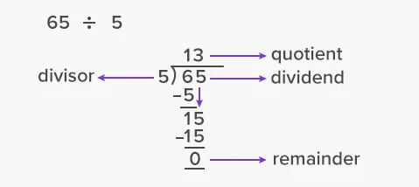
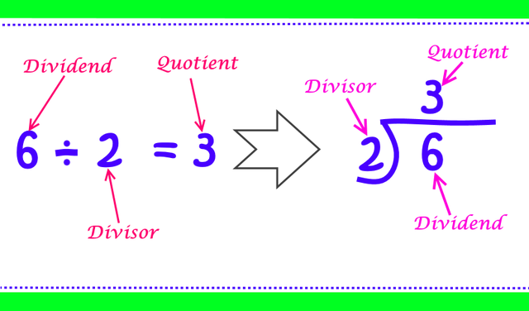
TERMS RELATED TO DIVISION

Slide 13
LONG DIVISION METHOD; STEPS
Divide
Multiply
Subtract
Bring down
MEMORY TRICK
D
DAD
MOM
SISTER
BROTHER
M
S
B

Slide 14
EXAMPLE
45 $÷$ 3

Slide 15
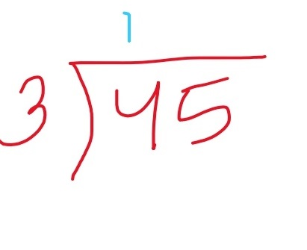
1st STEP
Start from left most digit (4 in 45 as shown)
How many times will 3 go into 45?
That’s too hard to work out in your head. Right! Then prove me wrong ;
So let’s break it down into smaller steps.
The first STEP you need to work out, is how many times can you divide 3 into 4.
The answer is 1. So you put 1 on the quotient line.

Slide 16
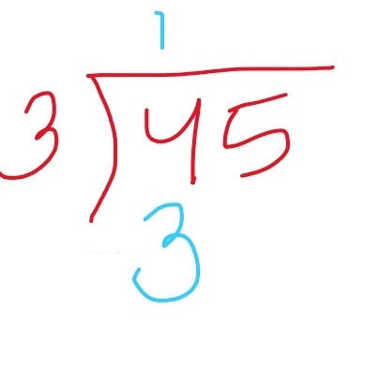
2nd STEP
You multiply your answer from step 1 and your divisor: 1 x 3 = 3. You write 3 under the 4.

Slide 17
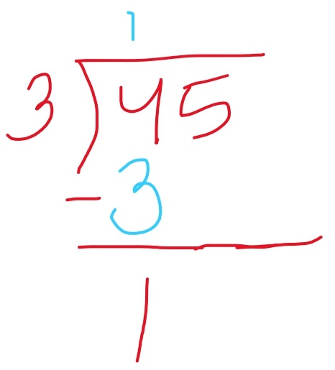
3rd STEP
Next you subtract. In this case it will be 4 – 3 = 1.

Slide 18
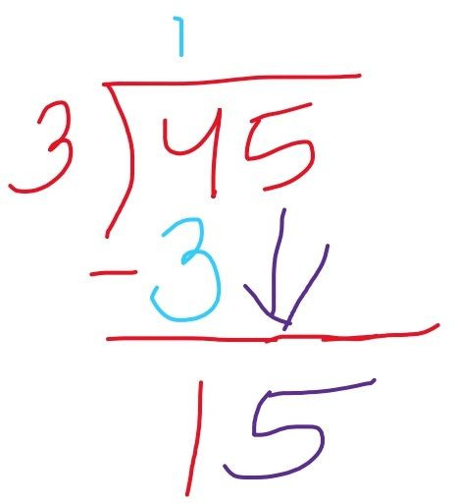
4th STEP
The last step in the sequence is to bring down the next number from the dividend, which in this case is 5. You write the 5 next to the 1, making the number 15.

Slide 19
FINAL STEP
Now do follow the DMSB rule
D (Divide)
M (Multiply)
S (Subtract)
B (Bring down)
as explained in the above slides.

Slide 20
STRATEGIES OF DIVISION
1. Addition
2. Subtraction
3. Simple division

Slide 21
Strategy-1 Addition
Add the divisor until you get the dividend digit.
Example: 18 ÷ 3 = 6
3+3=6+3=9+3=12+3=15+3=18
So here 3 is added 6 times hence the answer of the division is 6.

Slide 22
Strategy no. 2 Subtraction
Subtract the divisor from the dividend unless you get zero. The number of times you subtracted is the answer to your question.
Example: 18 ÷ 3
18-3=15
15-3=12
12-3=9
9-3=6
6-3=3
3-3=0
Here 3 is subtracted 6 times from 18 to get 0.
Hence the answer of the above division is 6

Slide 23
PROPERTIES OF DIVISION
1. Zero divided by any number is Zero
2. A number divided by one is the number itself
3. A number divided by itself is one.
4. We cannot divide any number by Zero.
1. 0 ÷ 9= 0
0 ÷ 30 = 0
0 ÷ 125=0
2. 47 ÷ 1 = 47
105 ÷ 1 = 105
7 ÷ 1 = 7
3. 5 ÷ 5 =1
20 ÷ 20= 1
120 ÷ 120 = 1

Slide 24
How to identify division words in word problems
Divide evenly
Cut
Split
Share
Each
Average
Equal
Out of
Ratio
Quotient

Slide 25
TRY THIS
Follow the steps as explained in the above slides to solve these questions.

Slide 26
LET’S PLAY THIS
Enjoy a beautiful track on Division

Slide 27
USE OF DIVISION IN WORD PROBLEMS
Rohan has 28 pencils. He shares them between his 5 friends. How many pencils will each of his friend get? How many pencils will Rohan have remaining?
The KEY WORDS from which we can understand that it is an example of division are – “SHARE and EACH”.

Slide 28
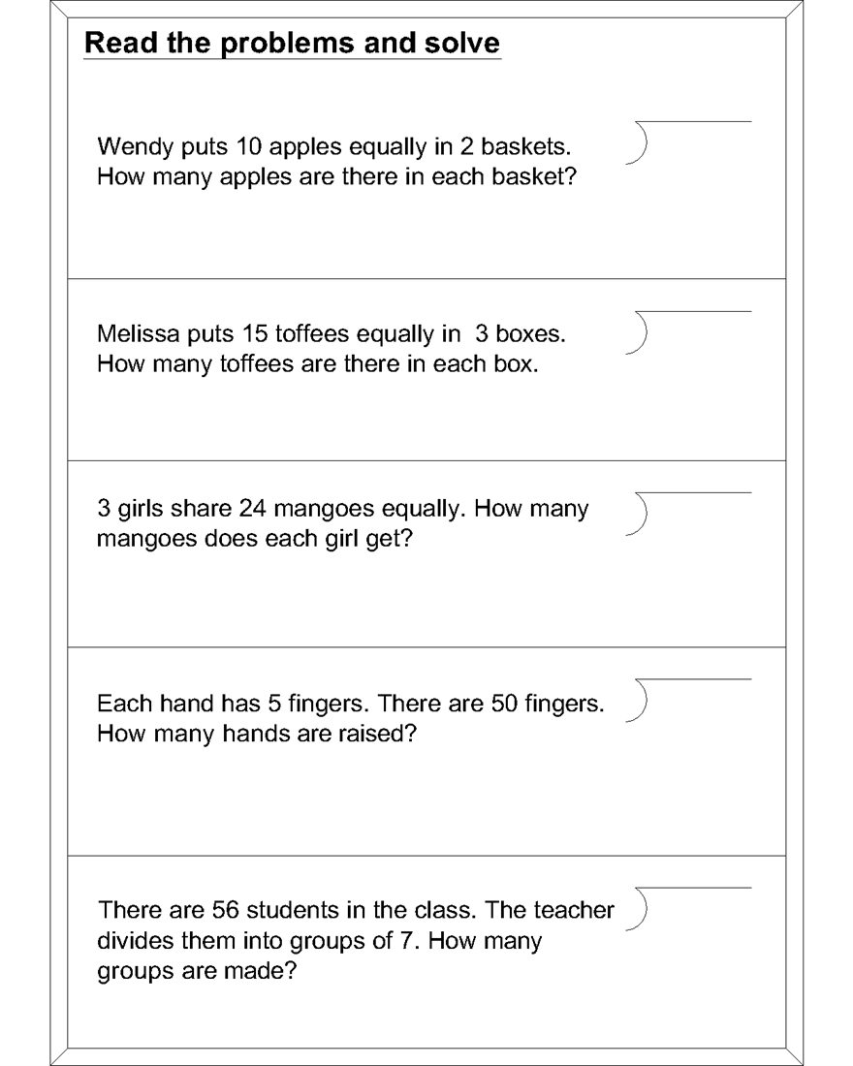
PRACTICE ON YOUR OWN
Questions

Slide 29
THANK YOU
Hope you enjoyed
End of slide

